Slide 1
Introduction to ModelMuse
Nov 19, 2010

Slide 2
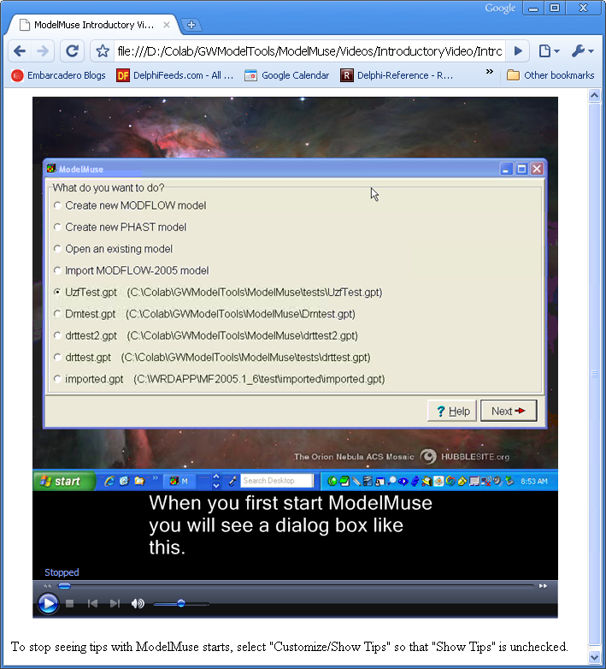
Videos Give Tips on ModelMuse

Slide 3
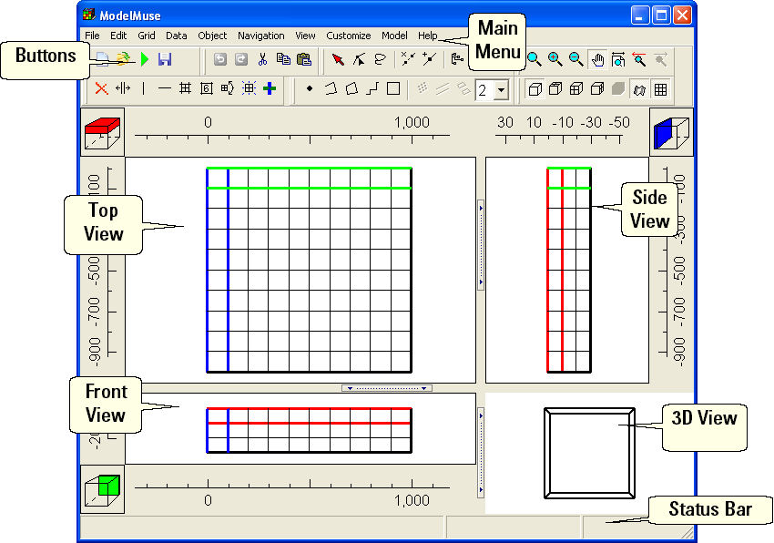
Main Form

Slide 4
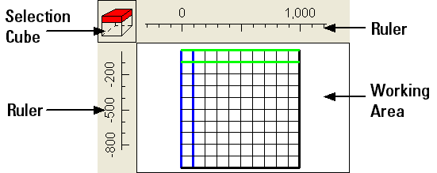
Top, Front, and Side Views

Slide 5
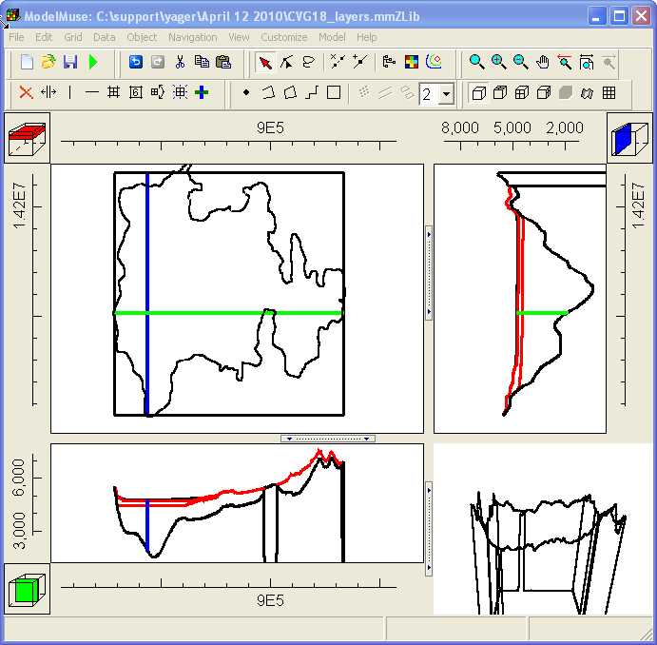
Colored Lines Indicate Selected Column, Row, and Layer

Slide 6
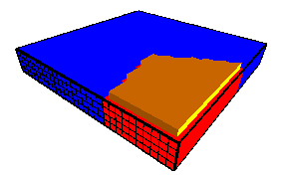
3D View

Slide 7
Navigation
Zoom
Zoom in
Zoom out
Pan
Undo change in view
Default view
Redo change in view

Slide 8
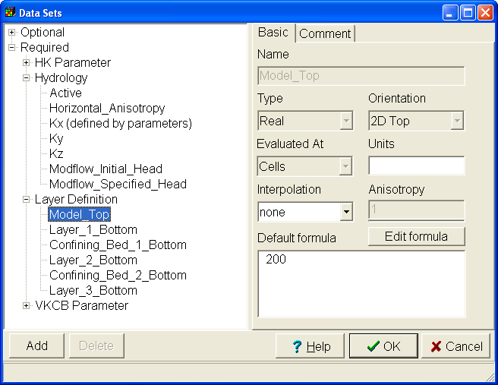
Data Sets Dialog Box

Slide 9
Data Sets Properties
Array of values corresponding to grid cells
Name
Type
Orientation
Interpolation algorithm
Default Formula

Slide 10
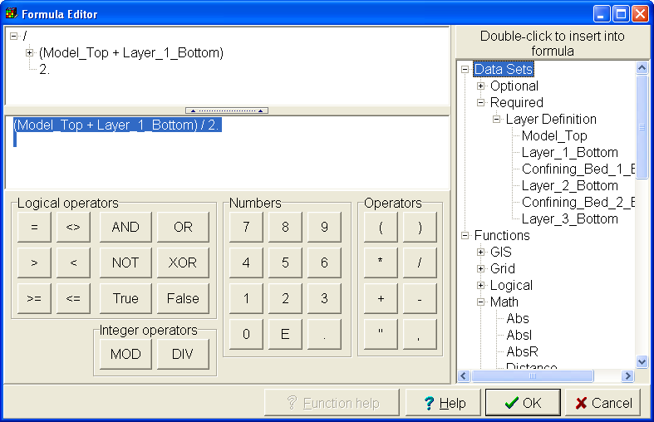
Formula Editor

Slide 11
Formulas
Mathematical expressions used to assign values to data sets
May result in different values at different locations
(Model_Top + Layer_1_Bottom) / 2.
CaseR(Layer, 0., 1E-6, 0., 0., 0.)

Slide 12
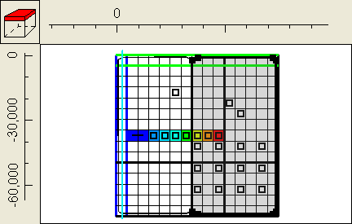
Objects

Slide 13
Objects
Points, Polylines, Polygons
Have 0, 1, or 2 third dimension formulas
Assign values to data sets and boundary conditions

Slide 14
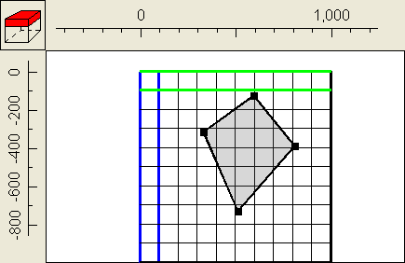
Creating Objects
Create objects
Add sections to objects

Slide 15
Editing Objects
Select object
Select a vertex
Delete a segment
Add a vertex

Slide 16
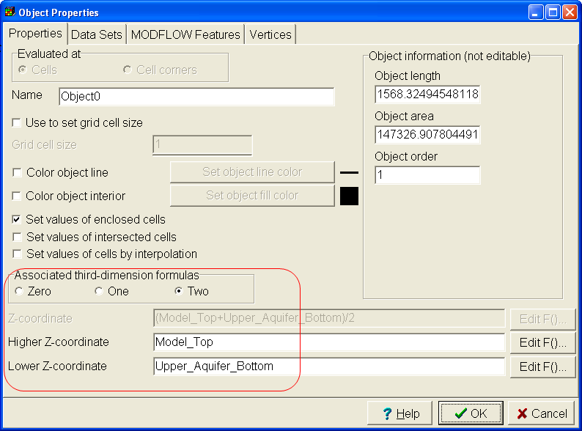
Object Properties Dialog Box
Use numbers or formulas to specify vertical position of objects

Slide 17
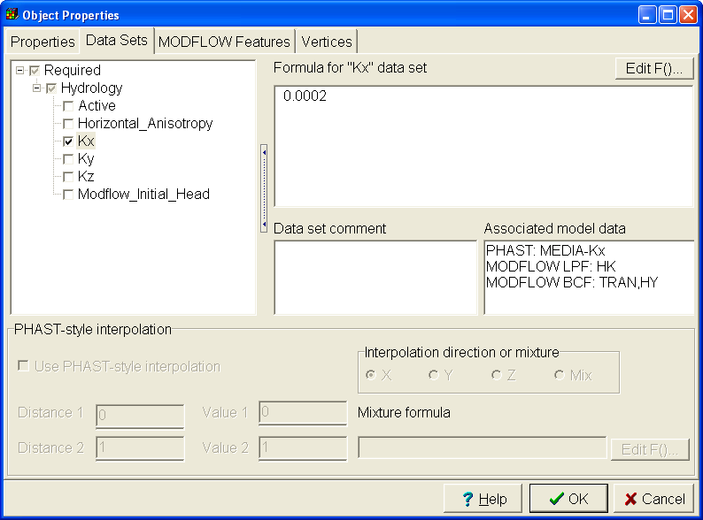
Assign Data Set Values with Objects
Set values of data sets using numbers or formulas.

Slide 18
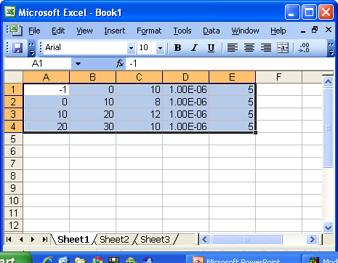
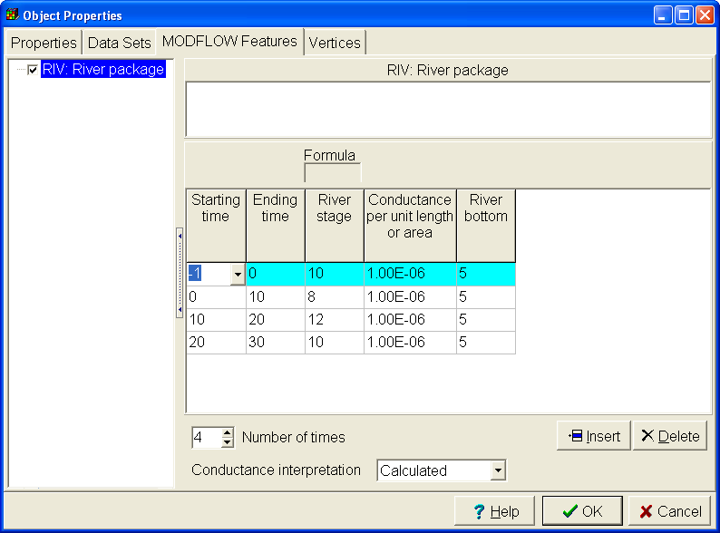
Object Properties Dialog Box
Copy from spreadsheets into ModelMuse tables

Slide 19
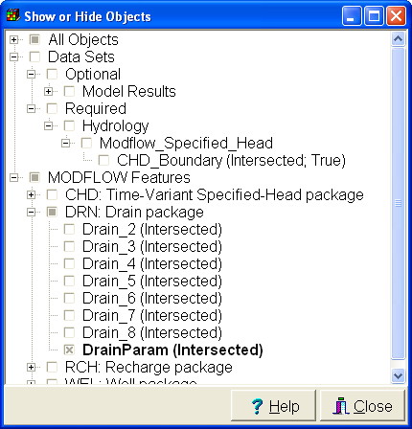
Show and Hide Objects

Slide 20
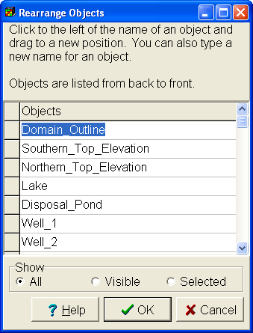
Object Order is Important

Slide 21
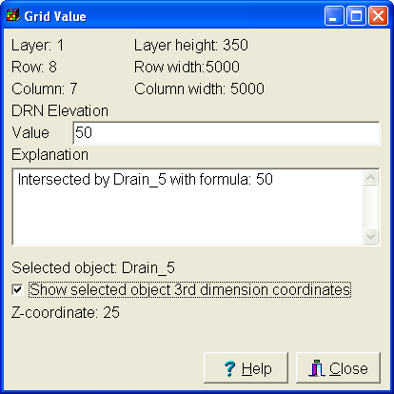
Grid Value Dialog Box

Slide 22
Grid Design

Slide 23
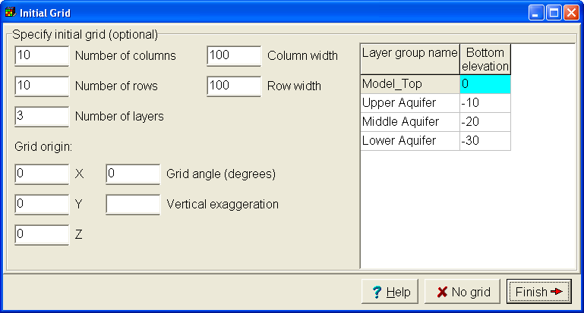
Initial Grid

Slide 24
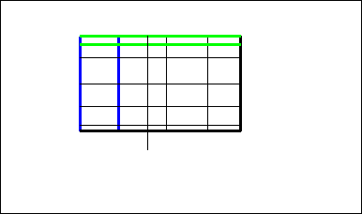
Create a Grid Manually

Slide 25
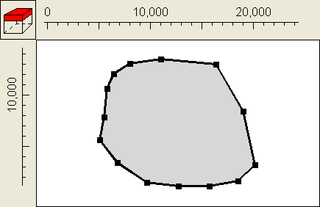
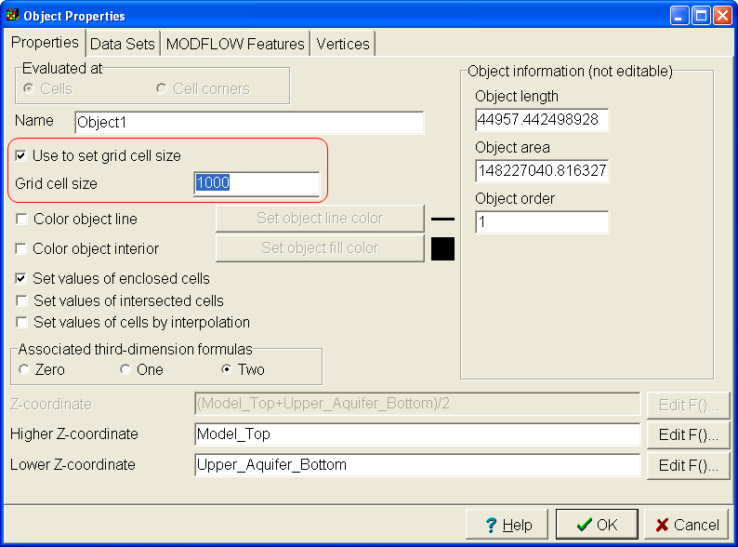
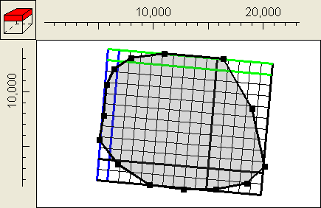
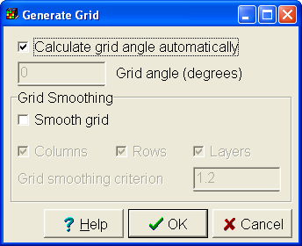
Use Objects to Define Grid

Slide 26
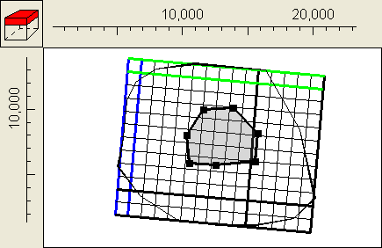
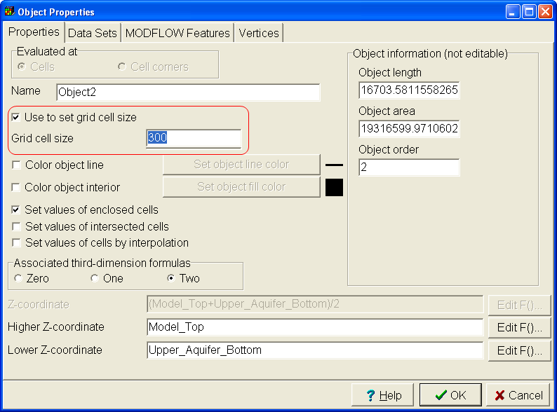
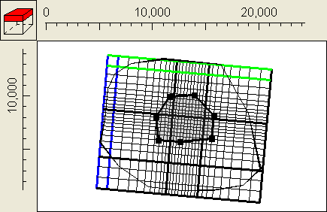
Refine Grid with Objects

Slide 27
Editing the Grid
You can:
Delete grid lines
Move grid lines
Add grid lines
Subdivide grid cells
Specify cell size
Rotate the grid

Slide 28
Importing Images and Data

Slide 29
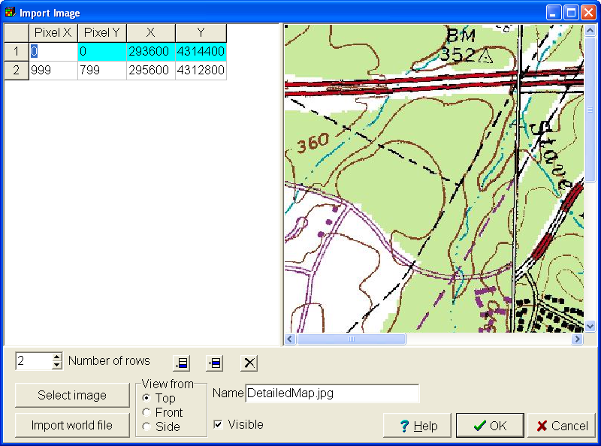
Importing Images

Slide 30
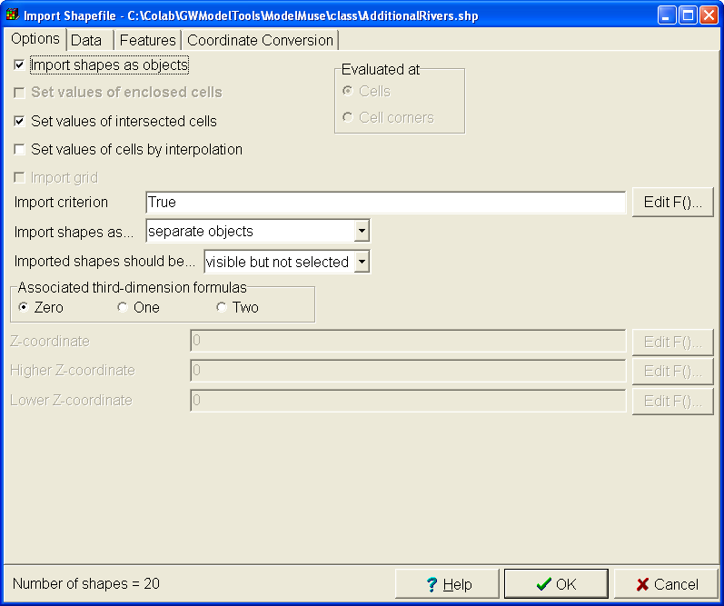
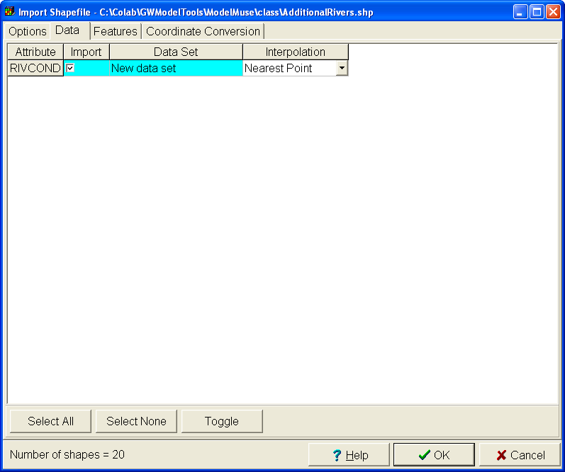
Importing Shapefiles

Slide 31
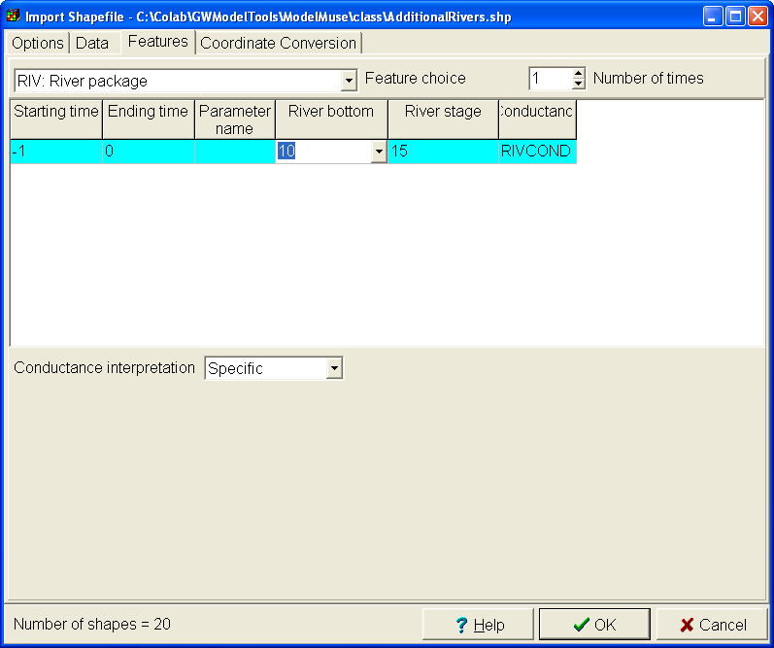
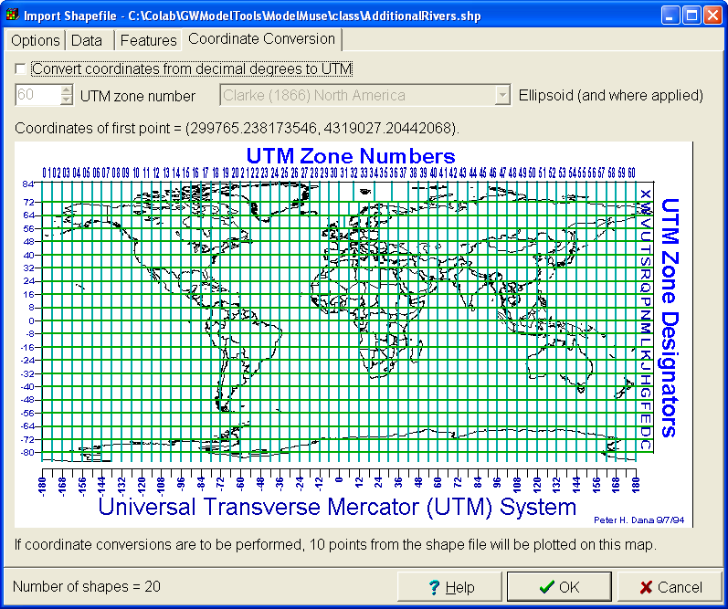
Importing Shapefiles (Continued)

Slide 32
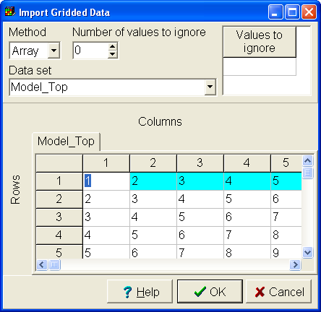
Import Gridded Data

Slide 33
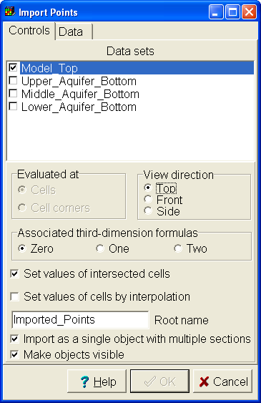
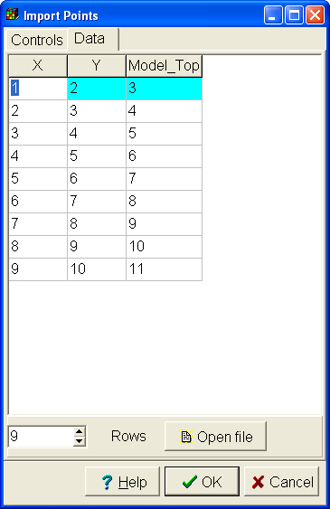
Import Points

Slide 34
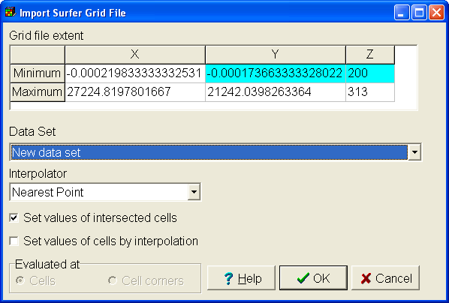
Import Surfer Grid File

Slide 35
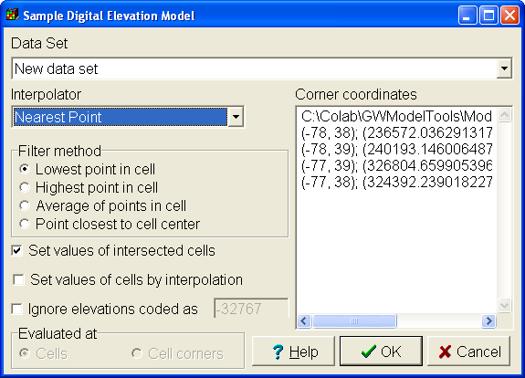
Sample Digital Elevation Model

Slide 36
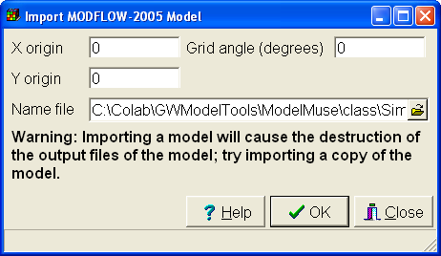
Import MODFLOW-2005 Model

